Slide 1
App ideas
Game app
Learning app
Challenges
Graphics

Slide 2
Gaming app
Fun Apps and inspiring concepts
Pokemon Go
Angry birds
Chappies bubble gum / fortune cookies.
The chappies bubble gum teaches you a small fact everytime you open the bubble gum package.
The fortune cookie gives you hope of some fortune
The app theme/environment
Varying degree from joyfull to horrific depending on player score

Slide 3
Learning app
Small introductory movies
Dynamical graphs showing global warming consequences.

Slide 4
Challenges
Are you convinced of the consequences of global warming, are they dire enough for you to change your habits.
Inform people of the consequences
Illustrative graps such as sea level rise, average temperature on earth related to GHG concentration (Anyone can fathom the consequence of an average earth temperature of 50 degrees celcius)
Is it hopeless to change your carbon footprint.

Slide 5
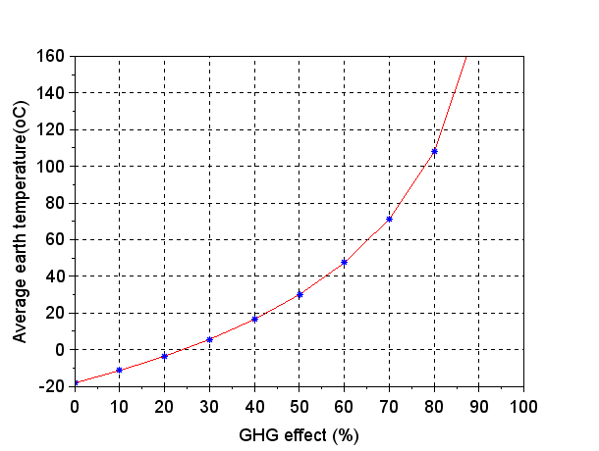
Graphics
Figure shows own calculation on GHG effect vs. earth temperature. A levelling based on the GHG effect illustrated in the app as changing landscape.
Landscape for selected blue spots from the graph, total fish death as example

Slide 6
Graphics
Sounds: Heavy breathing, calm breathing

